Slide 1
Point Cloud Processing
Ali Hosseininaveh

Slide 2
Table of Contents
Introduction
Typical and advance Point cloud Processing operations
PCL programming
How to install PCL and how to use the codes
Data Storage Formats
Segmentation
Classification
Filtering
Registration
Dynamic Registration
Surface Reconstruction
Visualization and Texturing

Slide 3
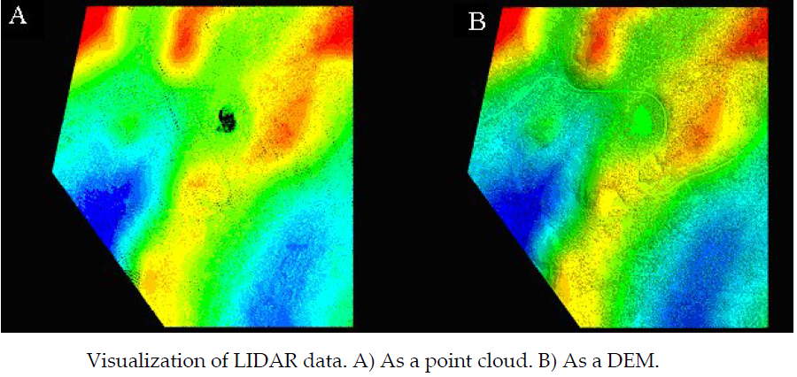
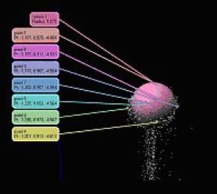
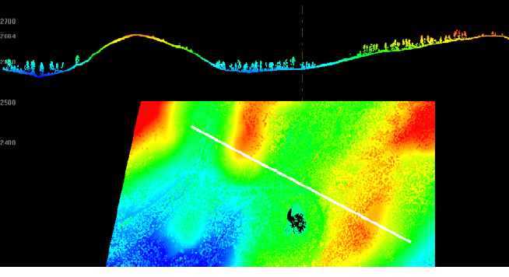
Typical Point Cloud Processing Operations
Visualization
Simple Point Display
TIN/DEM Display
Intensity Textured Point Cloud
RGB Textured Point Clouds
Color Coding
Image Rendering
Video Rendering
Zoom/Rotate/Navigate
Cross Section and Profile Generation
Measurements
Primitive Fitting

Slide 4
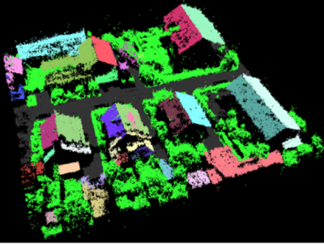
Typical Point Cloud Processing Operations
Segmentation
Segmentation refers to the operation that will segment or segregate points into different groups based on characteristics without knowledge of what they really are.
An example of segmentation could be the separation of points, based on intensity values, into low intensity, medium intensity and high intensity. Under this segmentation scheme points in each group will not necessarily share common spatial characteristics

Slide 5
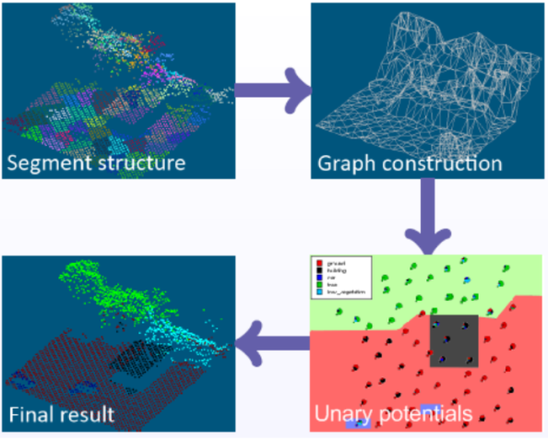
Typical Point Cloud Processing Operations
Classification
Classification implies the separation of points into different groups or classes defined by an intrinsic or natural characteristics.
An example of classification is the separation of the points into vegetation, building or ground classes; each of these groups implies the knowledge of its nature.

Slide 6
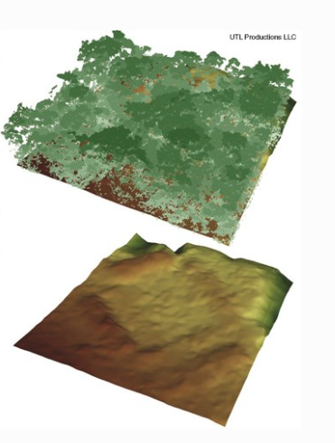
Typical Point Cloud Processing Operations
Filtering
Filtering is the removal of a set of points from the clouds based on either a segmentation or classification scheme.
An example of a segmentation scheme based filter could be the removal of points that are below a certain height value, without considering its nature (i.e. ground or low vegetation). A classification filter could be one that removes vegetation from an urban scene on which only brick and glass is wanted.

Slide 7
Typical Point Cloud Processing Operations
Transformation
Rotation and Transformation [R:t]
Cropping
Merging
Geo-Referencing
A transformation in which a point cloud with coordinates in arbitrary sensor space is converted into a geodetic coordinate frame is called geo‐referencing.
Gridding and sub-sampling
The process of converting the point cloud into a regularly spaced data set by means of interpolation is called gridding

Slide 8
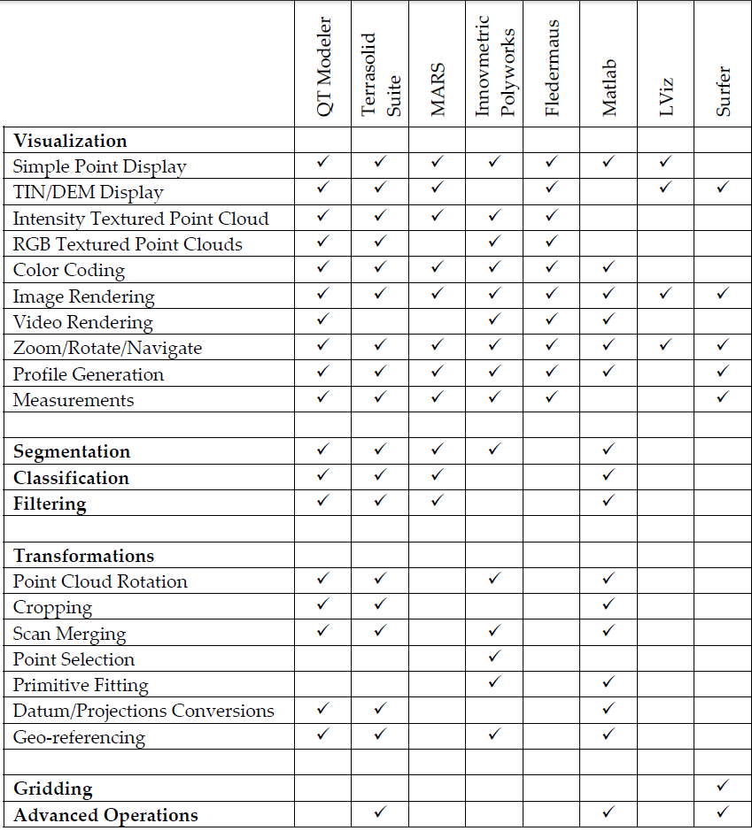
The available software for point cloud processing
QT Modeler
Pointtools
Terrasolid
MARS
Innovmetric Polyworks
Fledermaus
Lviz
Surfer
Revit
3DReshaper
Pointstream
GOM inspect
Cloud Compare
Geomagic
Meshlab
PCL
Matlab
XBIM

Slide 9
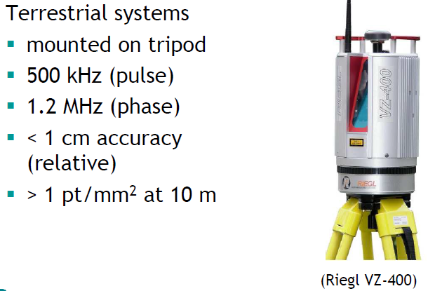
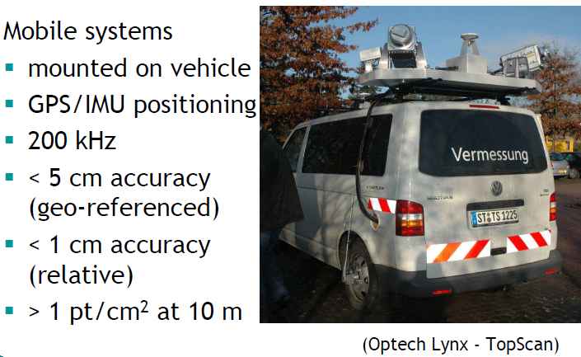
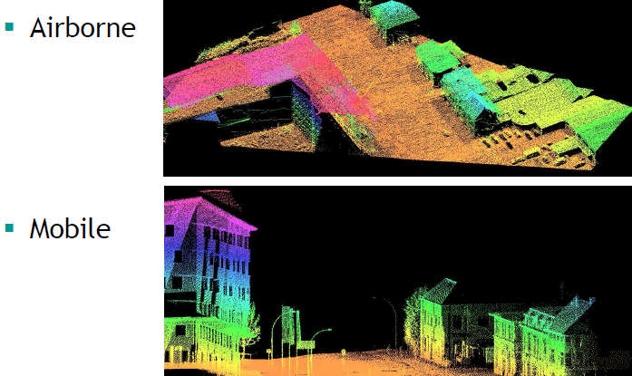
Advanced Point Cloud Processing Data acquisition platforms (ITC)

Slide 10
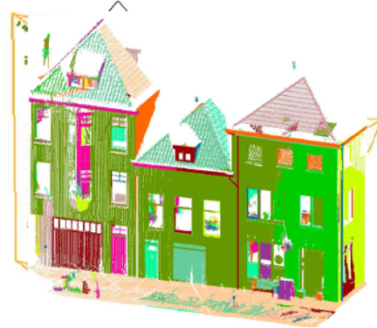
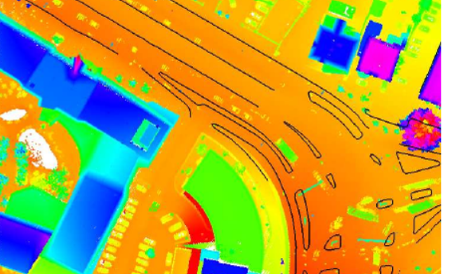
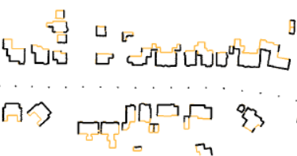
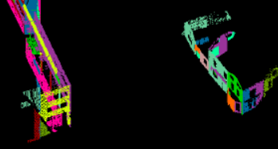
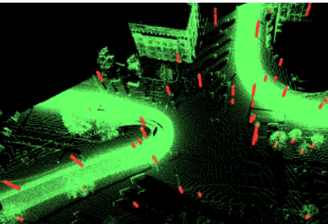
Advanced Point Cloud Processing (ITC)
Segmentation and Classification
3D Building Modelling
Curbstones
Road Marking
Poles of traffic signs and lights
Building Façade extraction, Modelling and Texturing

Slide 11
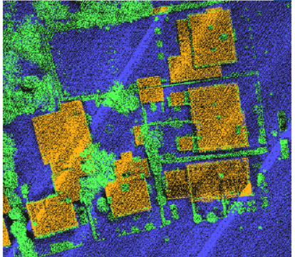
Advanced Point Cloud Processing (ITC)
Classification of Point clouds
Point based vs. segment based classification
Useful attributes to discriminate between buildings and vegetation
Height above the ground
Segment size

Slide 12
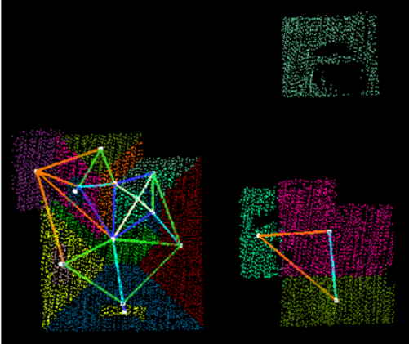
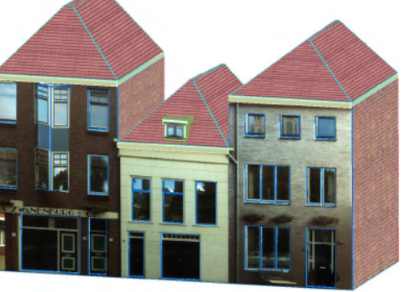
Advanced Point Cloud Processing (ITC)
3D Building Modelling
Graph matching for building reconstruction
Point cloud segmentation
Selecting of roof segments
Analysing of intersected lines and edge detection on the top of buildings
Roof Topology graph
Automatically aligning aerial and terrestrial point cloud for 3D Building Reconstruction

Slide 13
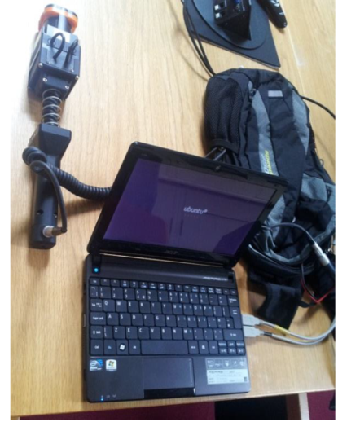
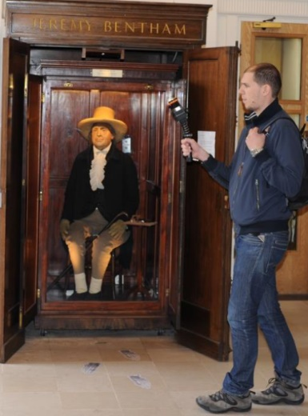
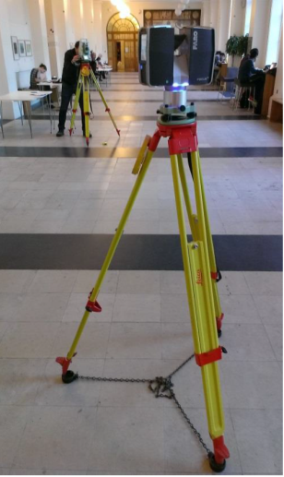
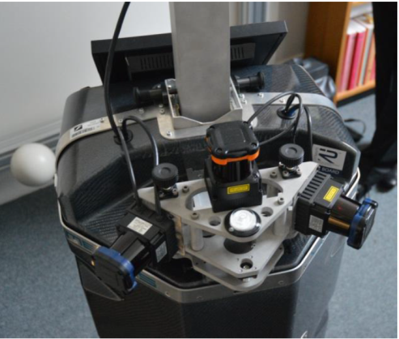
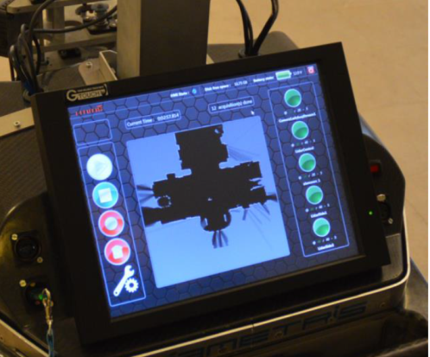
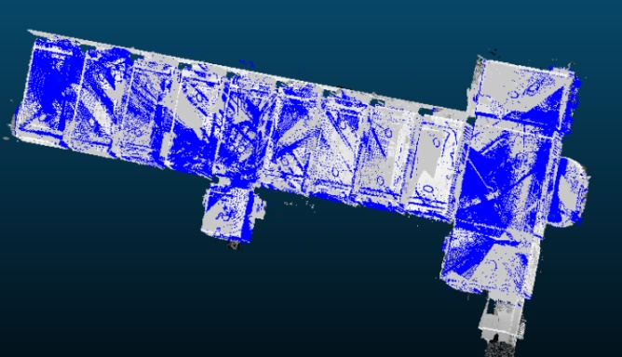
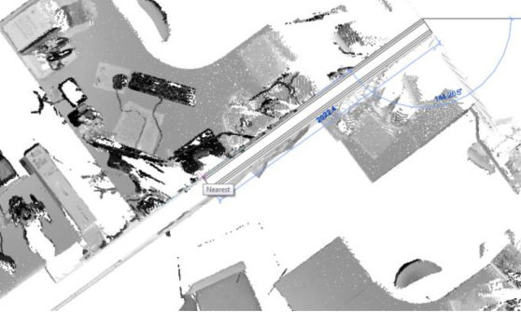
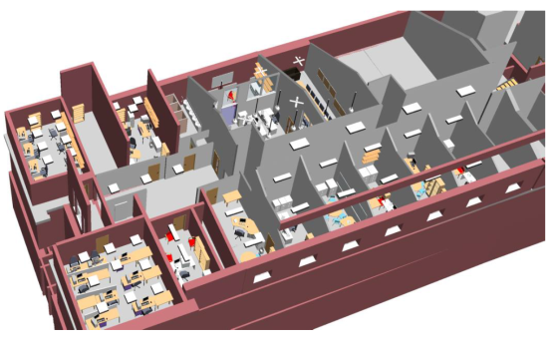
Advanced Point Cloud Processing (UCL)
Interior building reconstruction from point clouds
Data acquisition techniques (Indoor Mobile Mapping Systems (Viametris i-MMS or Zeb1, Terrestrial Laser scanner and Total Station)

Slide 14
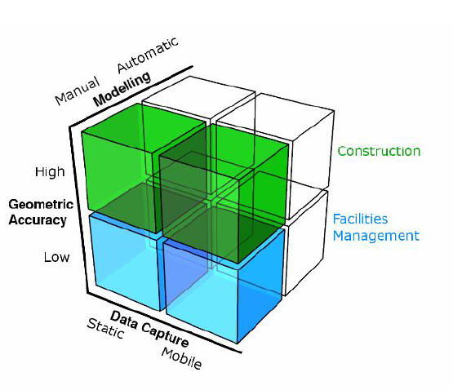
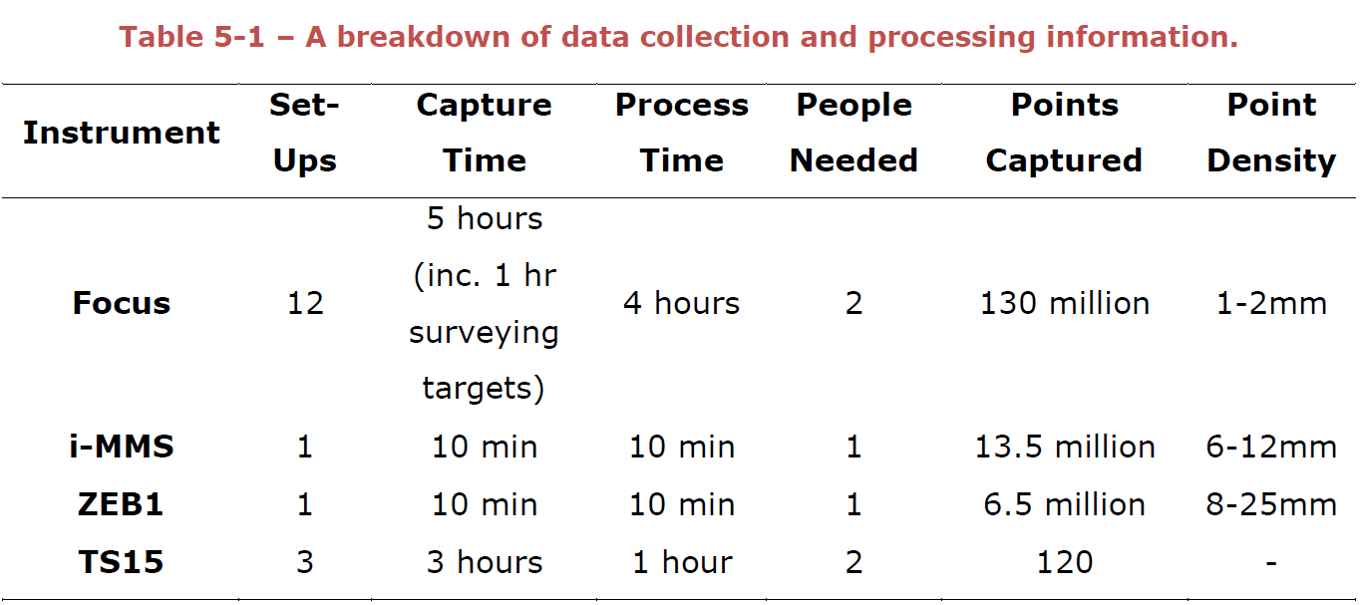
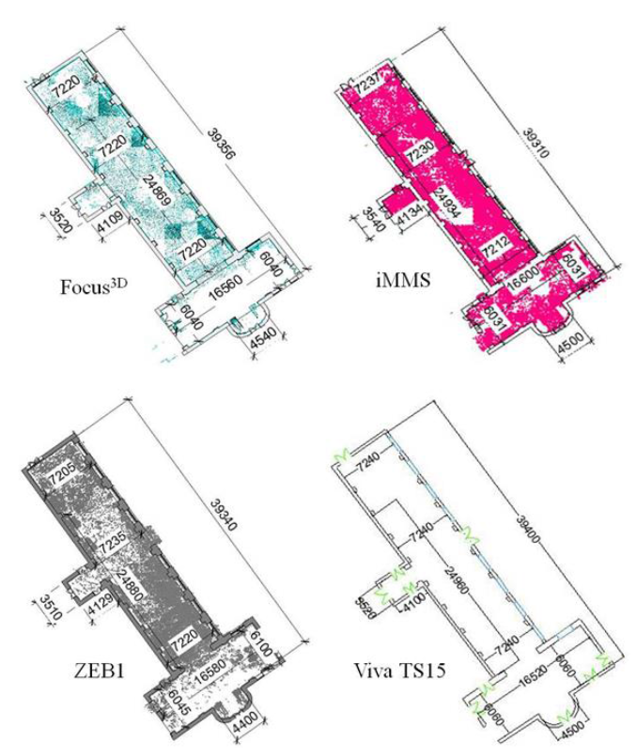
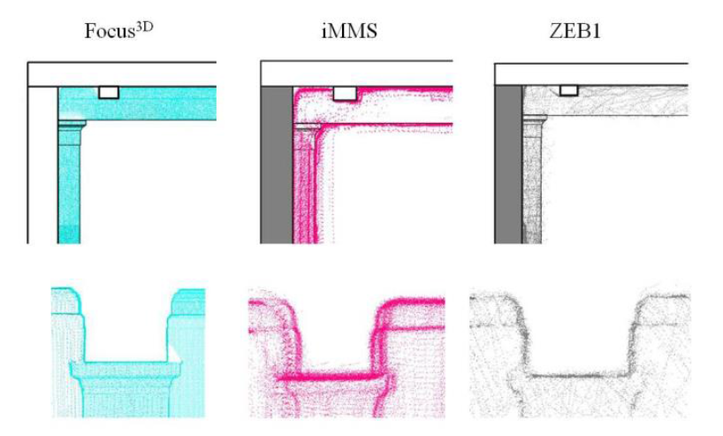
Advanced Point Cloud Processing (UCL)

Slide 15
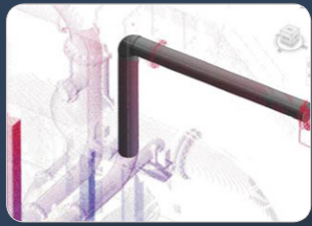
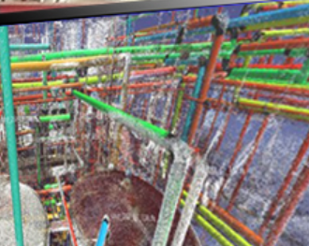
Advanced Point Cloud Processing (UCL)
Software used for semi automatic interior 3D reconstruction from point cloud
Scan to BIM (IMAGINiT Technologies) plugged in Revit software
Edgewise

Slide 16
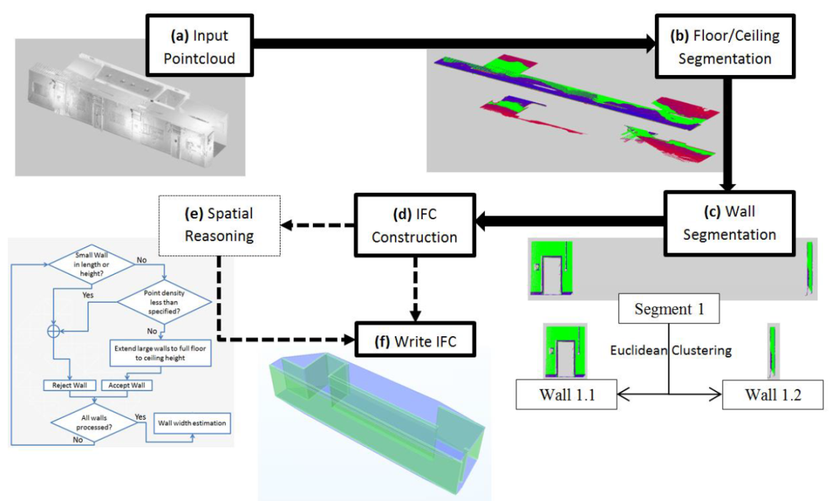
Advanced Point Cloud Processing (UCL)
A Fully automatic 3D reconstruction algorithm ( Thomson, 2016)
Libraries used for developing the algorithm:
eXtensible Building Information Modelling (xBIM) toolkit (http://docs.xbim.net/)
Point cloud Library (PCL)

Slide 17
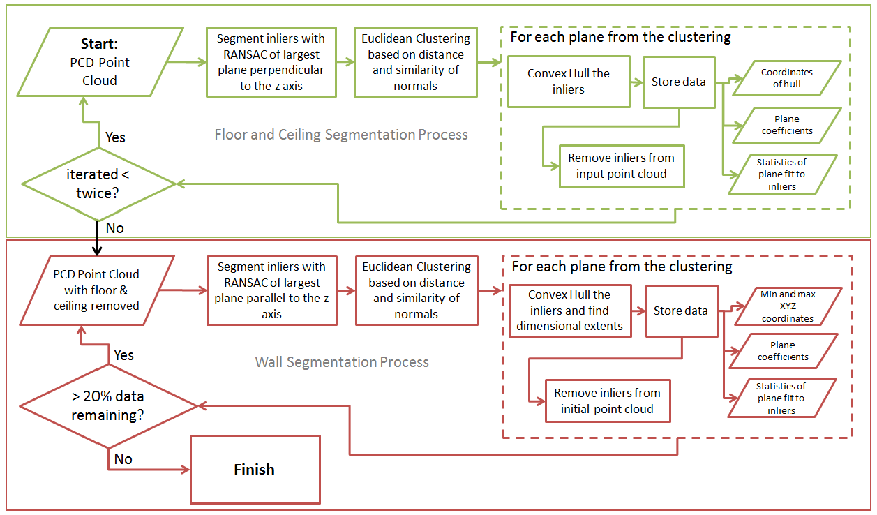
Advanced Point Cloud Processing (UCL)
The flowchart of the wall and ceiling segmentation algorithm (Thomson)

Slide 18
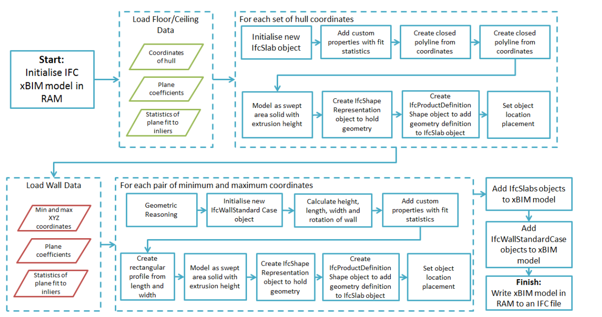
Advanced Point Cloud Processing (UCL)
Flowchart of the IFC construction process (Thomson)

Slide 19
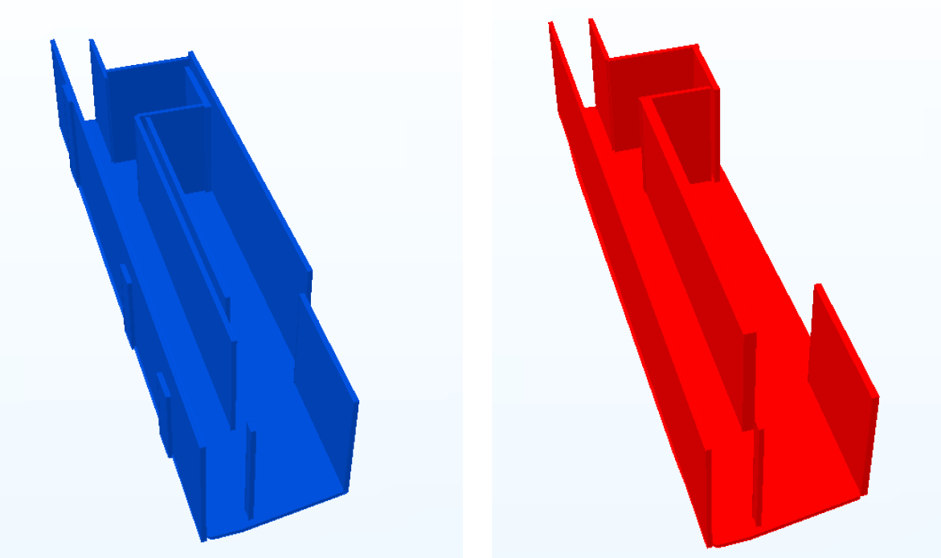
Advanced Point Cloud Processing (UCL)
Some spatial reasoning rules for better reconstruction:
Reject small walls
Extend large walls
Merge close planes with similar normal
Reject walls with low point density

Slide 20
Advanced Point Cloud Processing (ISPRS)
Development of new methodologies, algorithms and applications for point cloud processing
Information extraction from point clouds, including low-level feature extraction, segmentation and classification
Point cloud registration and fusion
Cloud Computing and high-performance computing for massive point cloud processing
Geospatial Big Data processing for point clouds
Point cloud rendering and streaming for massive point clouds
Point cloud processing for building information modelling (BIM)
Ubiquitous point cloud sensing

